Slide 1

St.ANN’S COLLEGE OF ENGINEERING AND TECHNOLOGY ELECTRICAL AND ELECTRONOCS ENGINEERING

Slide 2
REDUCTION OF CURENT RIPPLE BY USING INTERLAEVED BOOST CONVERTER FOR RENEWABLE ENERGY SOURCE

Slide 3
PROJECT NUMBERS
Y.SRINIVAS
P.SRILATHA
K.GOPAIAH
R.ASHOK KUMAR

Slide 4
UNDER THE GUIDENCE
G.RAMUDU_{M.TECH}

Slide 5
HEAD OF THE DEPARTMENT
S.V.D ANIL KUMAR_{M.TECH(Ph.D)}

Slide 6
ABSTRACT
Renewable energy is derived from natural resources that are replenished constantly. The commonly used renewable energy systems include photovoltaic cells and fuel cells.
A suitable DC-DC converter is proposed for highly efficient renewable energy systems.
Interleaved Boost Converter topology is discussed in this paper for renewable energy applications.
Three cases of interleaved boost converter have been considered and analyzed. Two-phase mc's with (i) the front end inductors magnetically coupled (ii) uncoupled inductors and (iii) inversely coupled inductors performance have been analyzed and compared.
The output voltage ripple, input current ripple and inductor current ripple of the three types of converters are compared.
The waveforms of input, inductor current ripple and output voltage ripple are obtained using MAT LAB/SIMULINK.

Slide 7
APPLICATION OF DC POWER
Hybrid vehicle

Slide 8
HOW TO GET THE VARIABLE DC POWER
BUCK CONVERTER
BOOST CONVERTER
BUCK BOOST CONVERTER

Slide 9
DRAWBACKS OF BOOST CONVERTER
Direct effect of input output voltage
Not suitable for high power conversion
low amount of dc step up

Slide 10
INTEGRATED GATE BIPOLAR JUNCTION TRANSISTER
IT PROVIDES HIGH INPUT IMPEDENCE
IT IS CURRENT CONTROL DEVICE
IT HAS MEDIUM POWER CAPABILITY

Slide 11
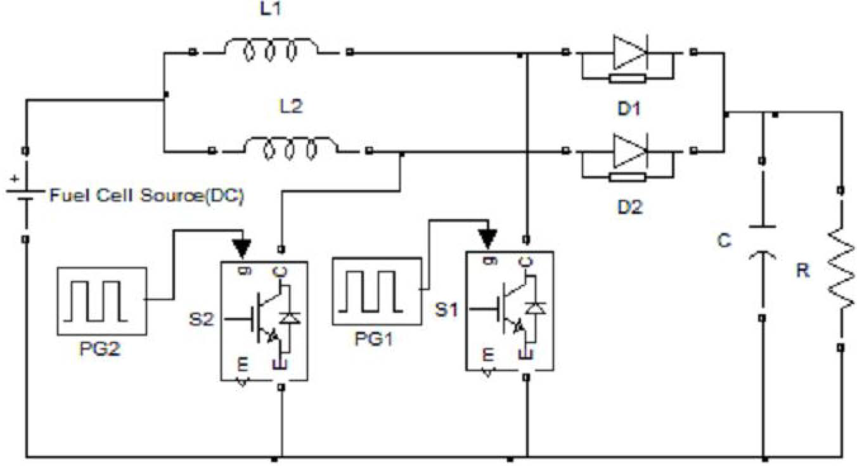
TWO PHASE UNCOUPLED IBC

Slide 12
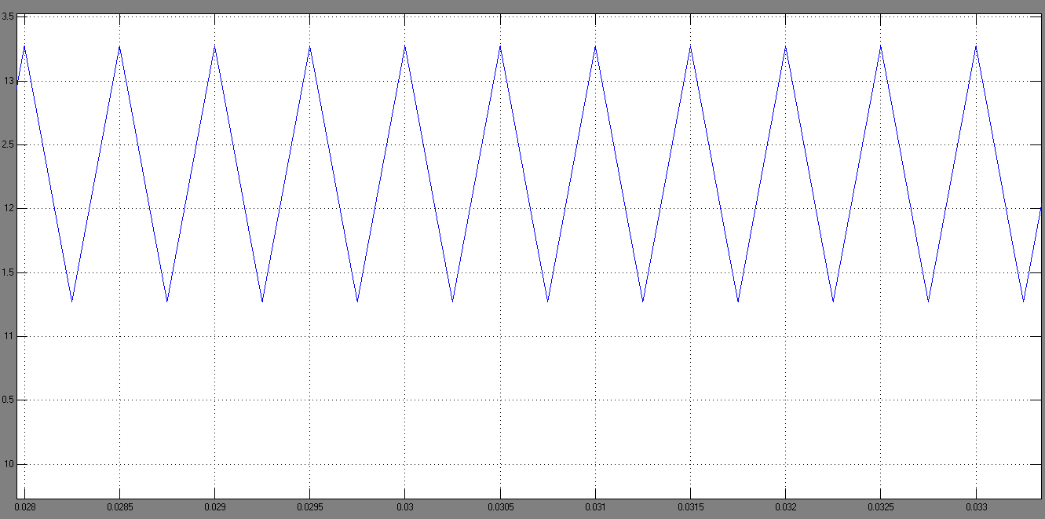
Inductor current ripple waveform of directly coupled IBC

Slide 13
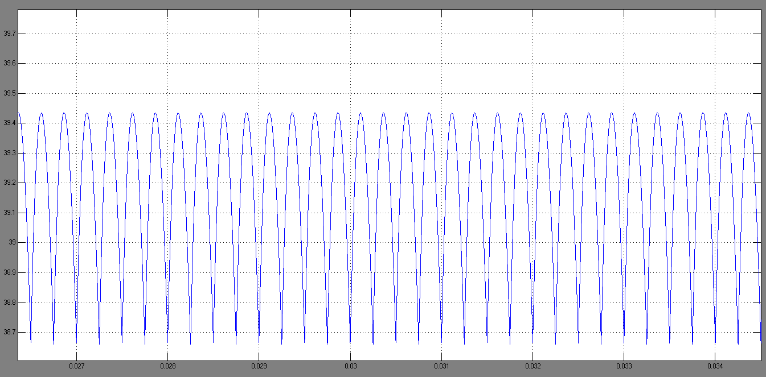
Output voltage waveforms of indirectly coupled IBC

Slide 14
COUPLED INDUCTORS

Slide 15
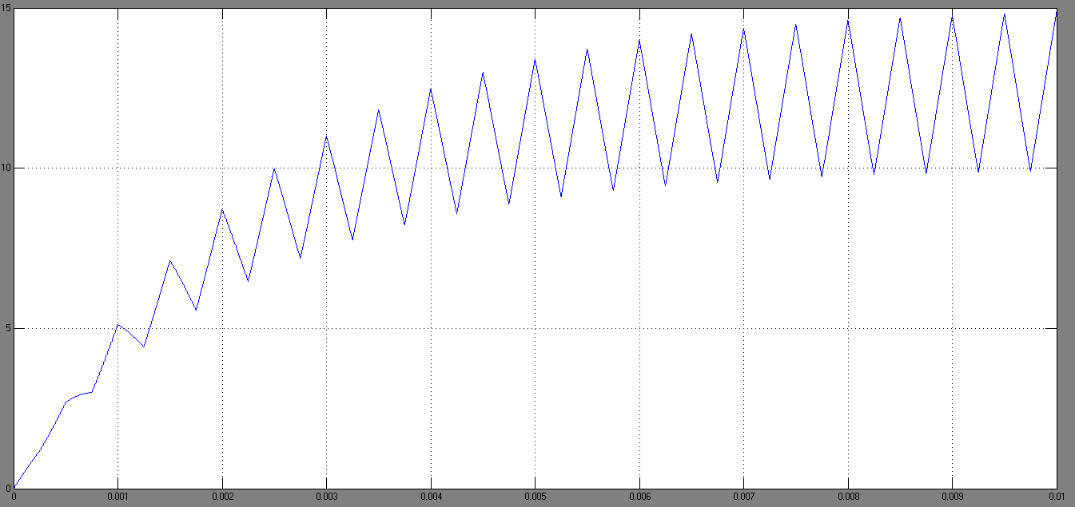
INDUCTOR CURENT FOR DIRECTLY COUPLED

Slide 16
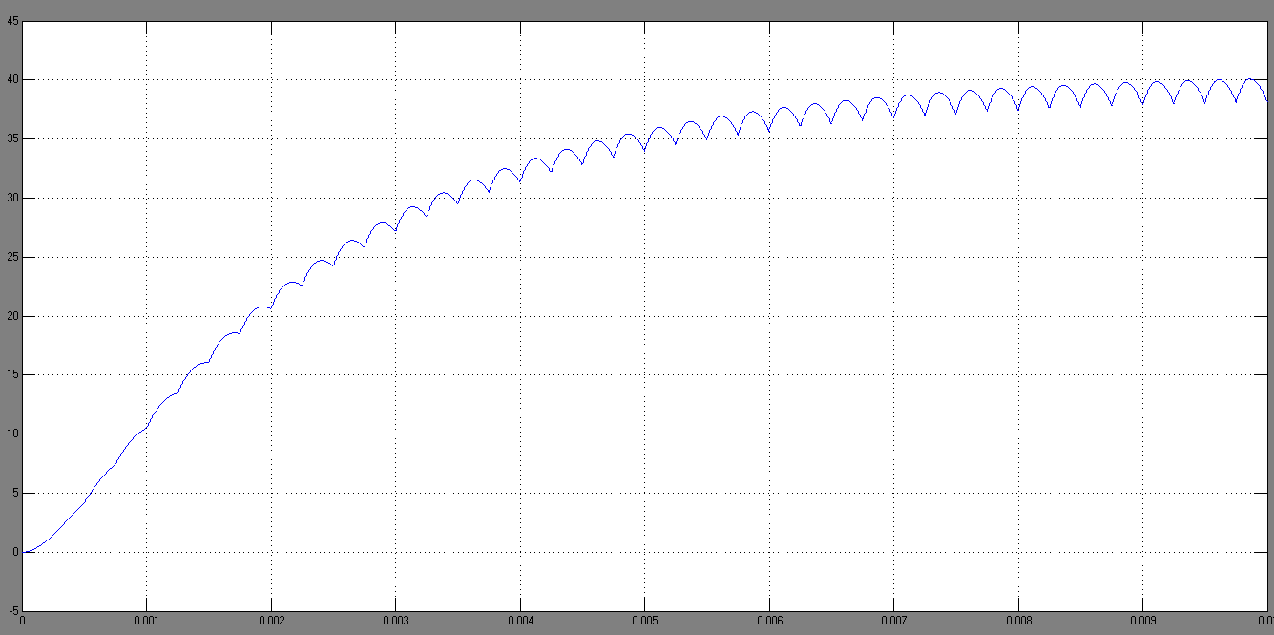
OUTPUT VOLTAGE FOR DIRECTLY COUPLED

Slide 17
INVERSELY COUPLED

Slide 18
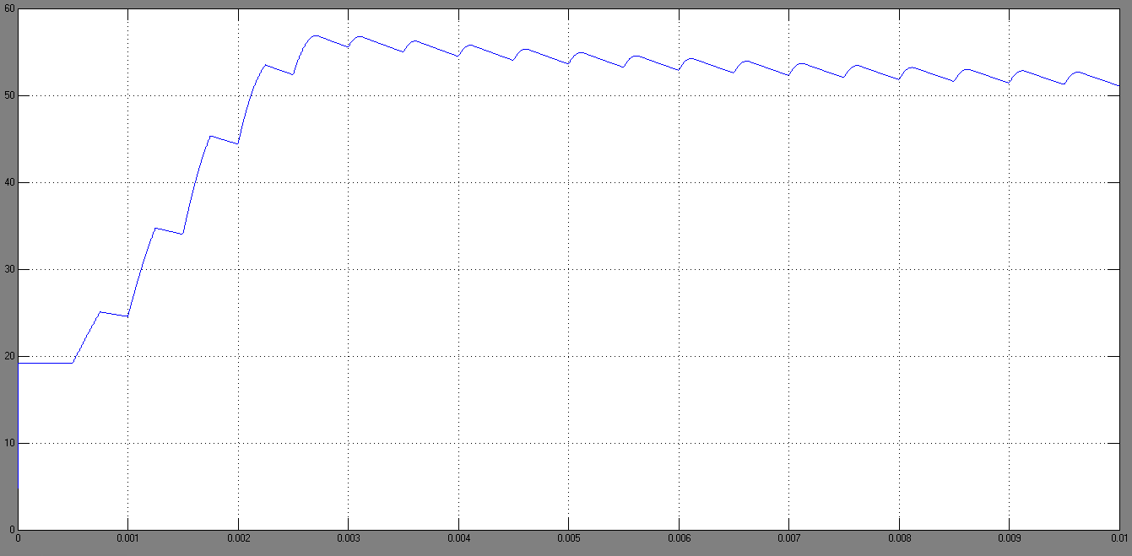
OUTPUT VOLTAGE FOR INVERSELY COUPLED

Slide 19
CONCLUSION
Interleaved boost converter has so many advantages and is a suitable converter for renewable energy applications. Three cases of IBC using uncoupled, coupled and inversely coupled inductor have been analyzed for renewable energy applications. Their design equations have been presented and performance parameters of all three cases have been compared using simulation. It is demonstrated that the directly coupled interleaved DC-DC converter effectively reduces the overall current ripple compared to that of uncoupled inductors. Therefore directly coupled IBC is a suitable choice for fuel cells.

Slide 20
THANK YOU

